Slide 1

Mini Project-II (ID-202BP) Even Semester Session 2024-25
Quest Explorer: A Text-Based Adventure Game
Name: Pragya Tiwari & University Roll Number: 202410116100144
Name: Prasannajeet & University Roll Number: 202410116100145
Name: Preksha Ruhela & University Roll Number: 202410116100148
Name: Priyakant Tyagi & University Roll Number: 202410116100151
Project Supervisor:
Dr. Vipin Kumar
Assistant Professor

Slide 2
Content
Introduction
Objective of the Project
Technology
Hardware Requirements
Software Requirements
Modules
Working
Workflow
References
Notes:
Font Styles: Times New Roman + Font Size: 25

Slide 3

Introduction
The Text-Based Adventure Game is an interactive command-line game built using Java and Data Structures. In this game, players explore different rooms, collect and manage items, and navigate through a virtual world by entering simple text commands like go, take, drop, and look.
This project applies Object-Oriented Programming (OOP) concepts, utilizing HashMaps and Arrays to efficiently manage rooms, items, and player actions. The game enhances problem-solving skills by simulating a dynamic environment where players make decisions based on their surroundings.
By developing this game, we aim to showcase how data structures and logical programming can be used to create interactive and engaging applications.
Notes:
Font Styles: Times New Roman + Font Size: 25

Slide 4

Objective of the Project
The primary objective of the Text-Based Adventure Game is to develop an interactive command-line game by:
Creating an immersive text-based adventure where players explore different rooms and interact with the environment using text commands.
Enhancing problem-solving and logical thinking by simulating real-world decision-making through interactive gameplay.
Building a structured and modular Java program that follows best coding practices for scalability and maintainability.
Providing a simple yet engaging gaming experience that allows users to navigate, collect items, and make strategic choices within the game.
Notes:
Font Styles: Times New Roman + Font Size: 25

Slide 5
Technology (Hardware Requirements)
Processor: Minimum Intel Core i3 (Recommended: Core i5 or higher)
RAM: Minimum 4GB (Recommended: 8GB or higher)
Storage: At least 500MB free space (Recommended: 1GB)
Graphics: Integrated graphics (No dedicated GPU required)
Notes:
Font Styles: Times New Roman + Font Size: 25

Slide 6



Technology (Software Requirements)
Programming Language: Java (JDK 8 or higher)
Development Environment: Eclipse IDE, IntelliJ IDEA, or NetBeans
Libraries & Concepts Used: HashMap's, Array Lists, Object-Oriented Programming (OOP)
Operating System: Windows, macOS, or Linux
Eclipse IDE
JAVA
Java Development Kit (JDK)
Notes:
Font Styles: Times New Roman + Font Size: 25

Slide 7
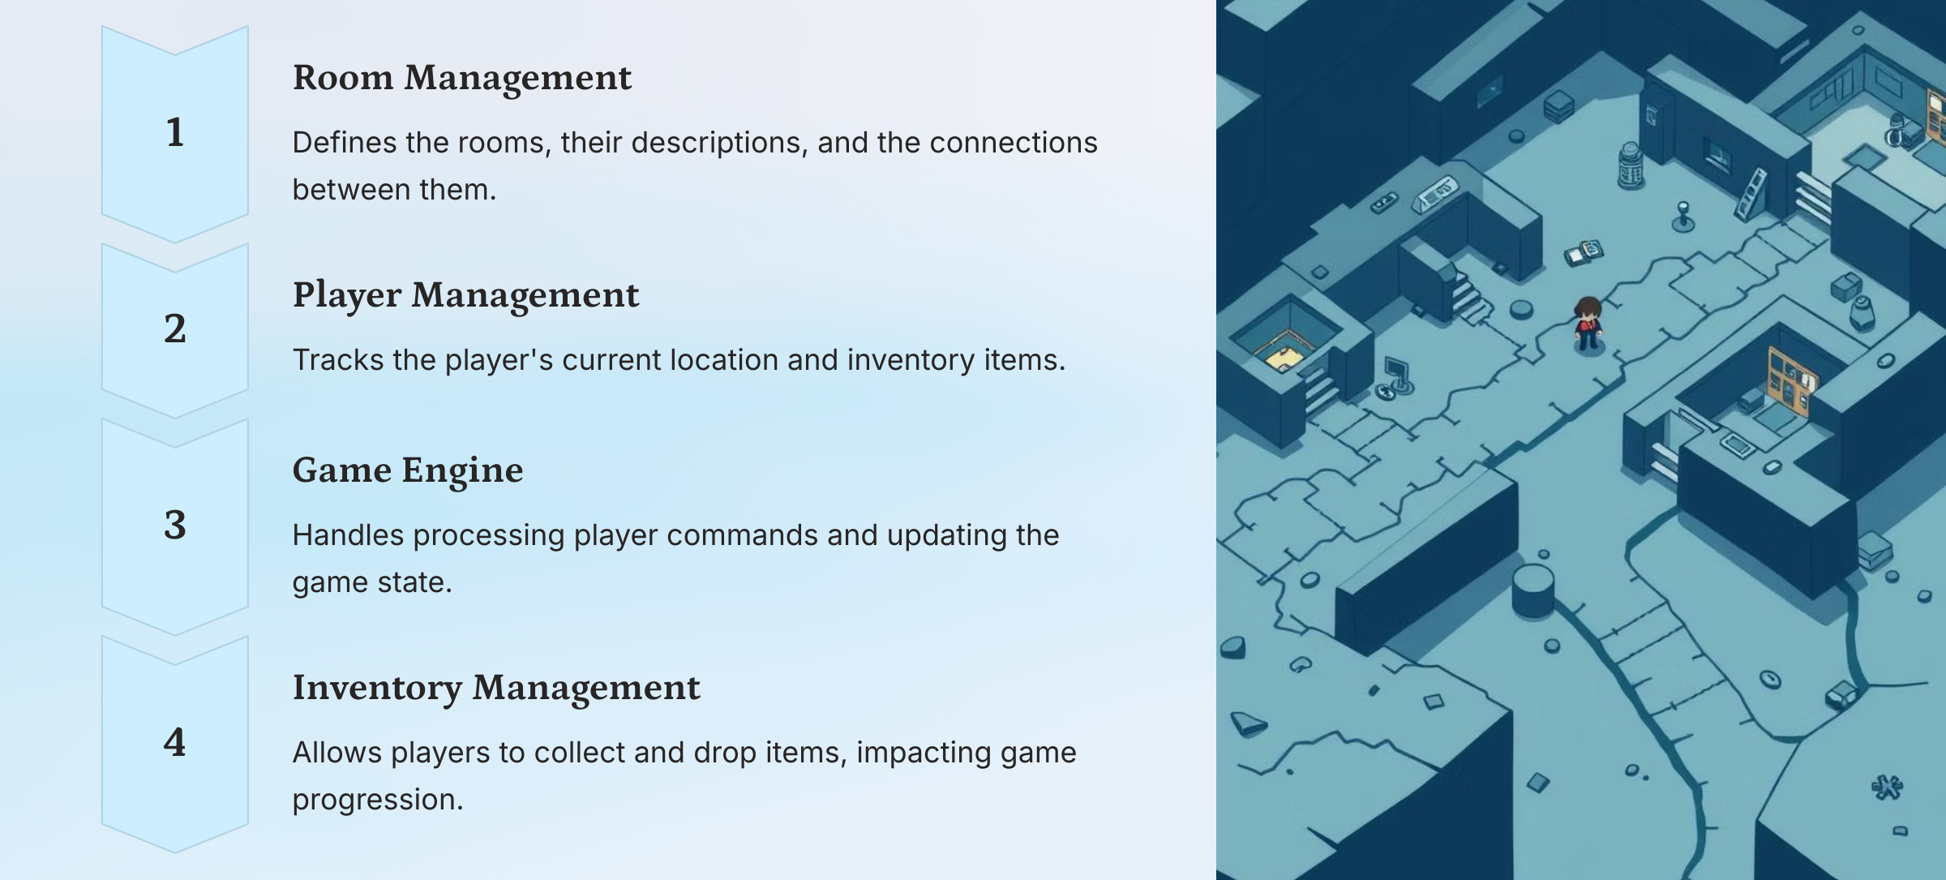
Game Modules
Notes:
Font Styles: Times New Roman + Font Size: 25

Slide 8
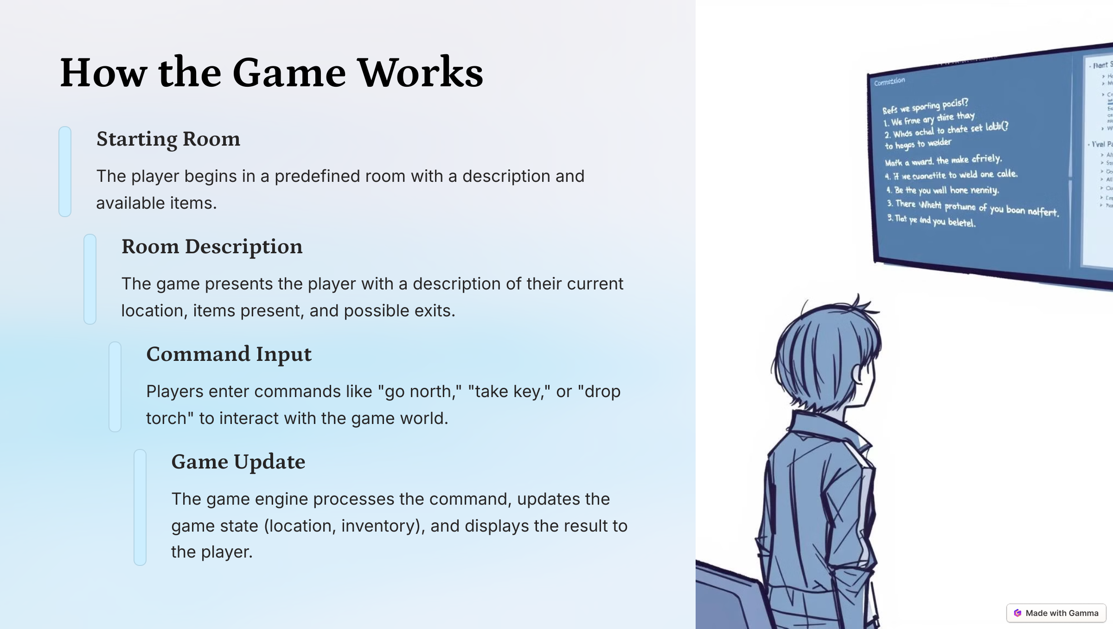
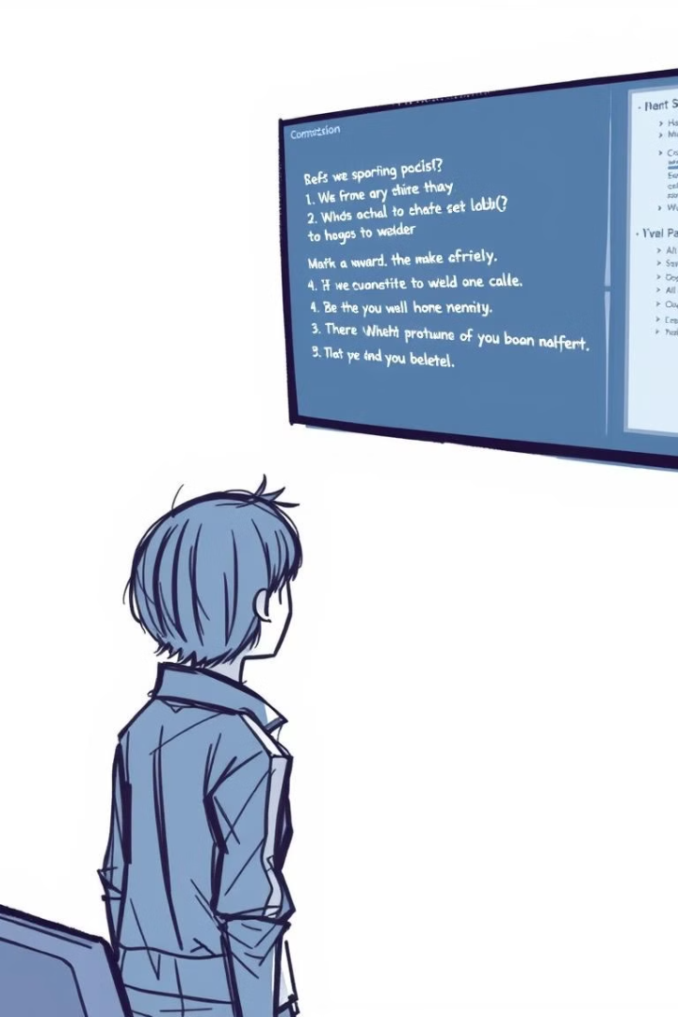
How the Game Works
Notes:
Font Styles: Times New Roman + Font Size: 25

Slide 9
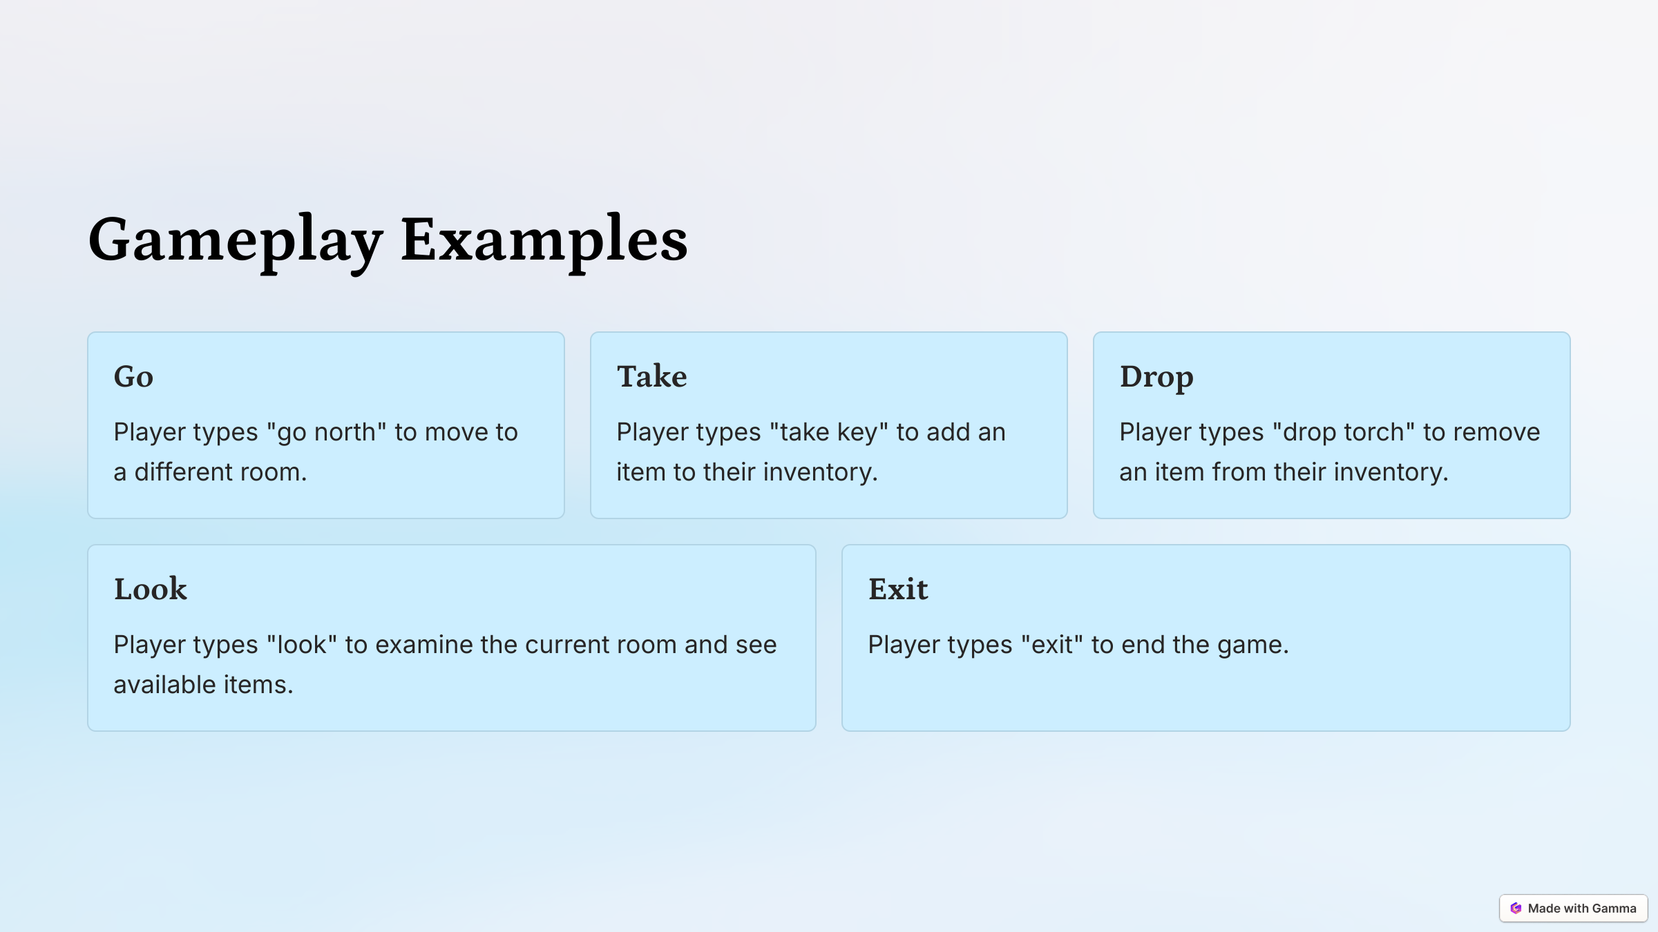
Game Play Examples
Notes:
Font Styles: Times New Roman + Font Size: 25

Slide 10
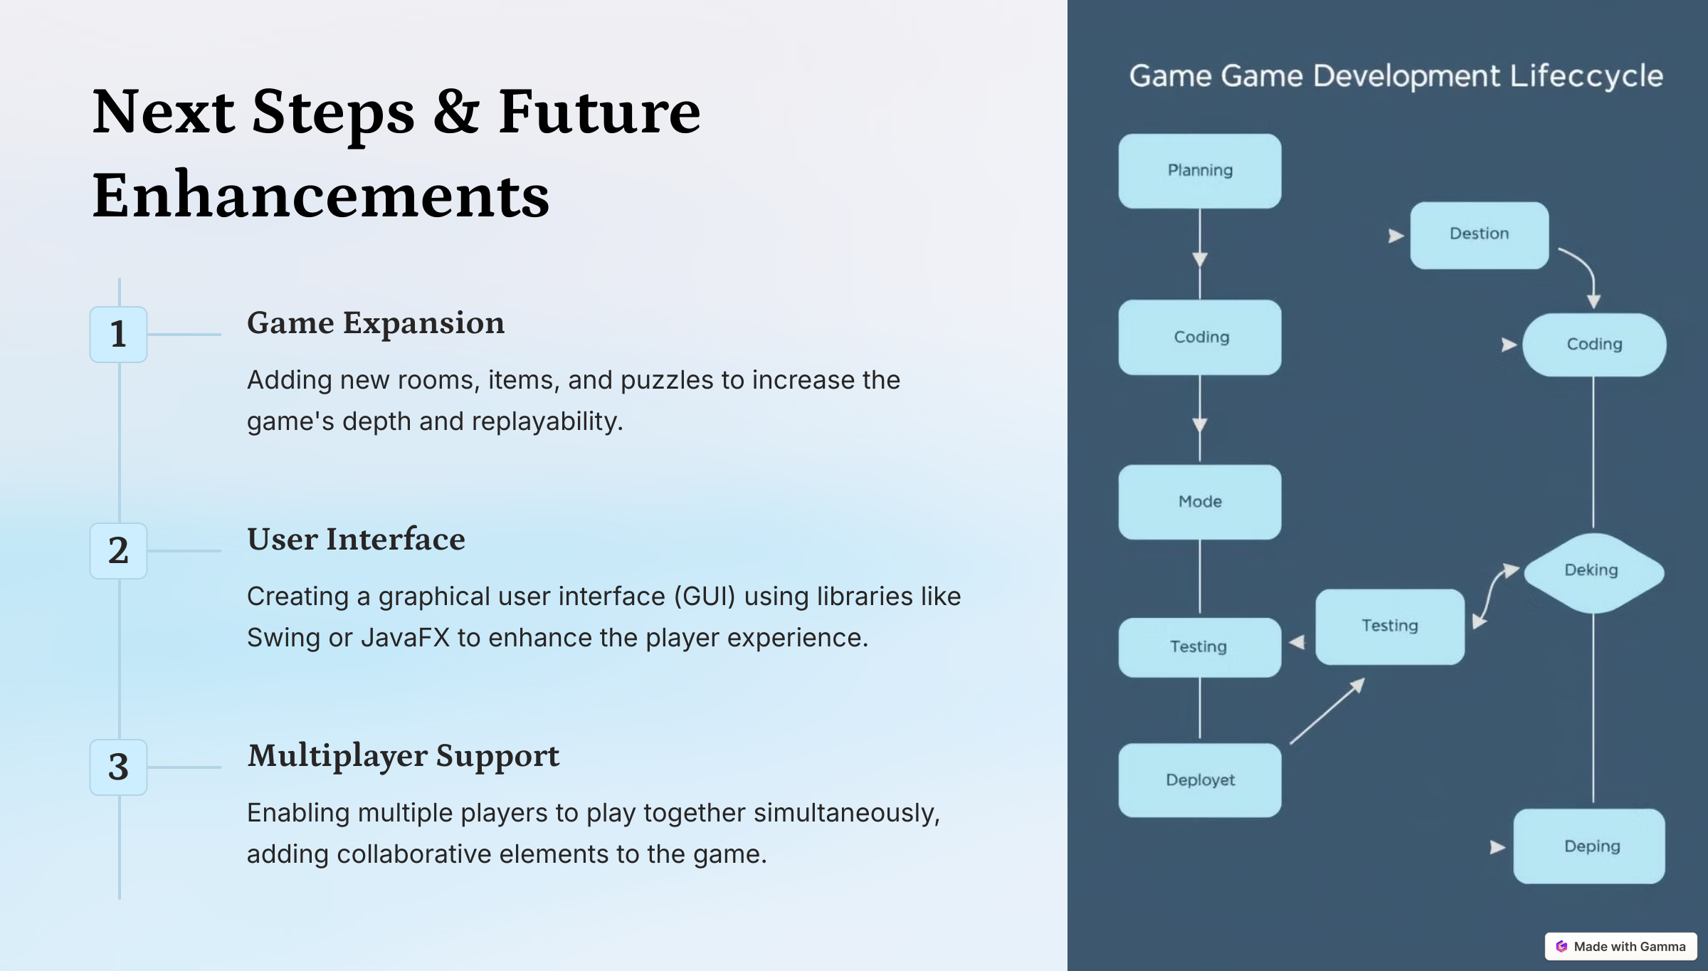
Game Development Life Cycle
Notes:
Font Styles: Times New Roman + Font Size: 25

Slide 11
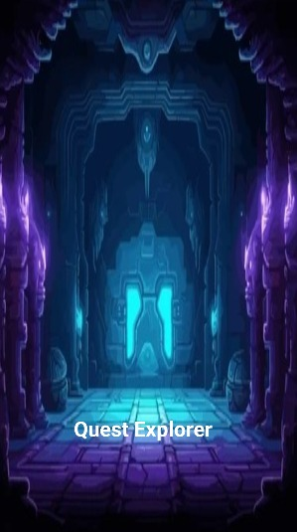
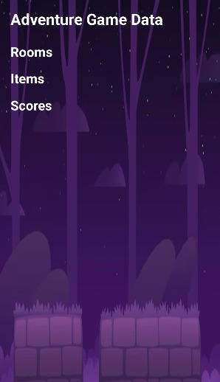
Snapshots
1:- 2:-

Slide 12
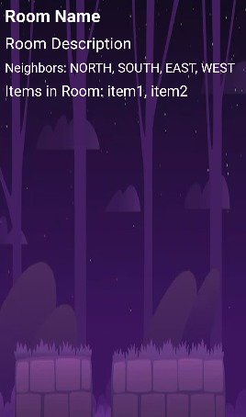
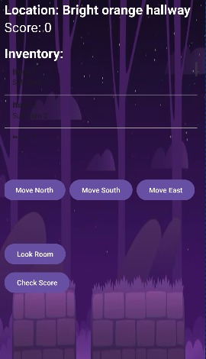
Snapshots
3:- 4:-

Slide 13
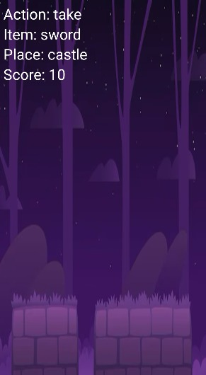
Snapshots
5:-

Slide 14
References
Geeks For Geeks
YouTube:- Dr. Vipin Classes
Notes:
Font Styles: Times New Roman + Font Size: 25

